Slide 1

MASK DETECTION
A Project Presentation by: -
Dattatraya Deb
Govind Yadav
Under the Guidance of
Prof. Suresh Chandra Moharana
School of Computer Engineering
KIIT Deemed to be University, Bhubaneswar, Odisha- 751024

Slide 2
INTRODUCTION
Rapid advancements in the fields of Science and Technology have led us to a stage where we are capable of achieving feats that seemed improbable a few decades ago. Technologies in fields like Machine Learning and Artificial Intelligence have made our lives easier and provide solutions to several complex problems in various areas. Modern Computer Vision algorithms are approaching human-level performance in visual perception tasks. From image classification to video analytics, Computer Vision has proven to be a revolutionary aspect of modern technology. In a world battling against the Novel Coronavirus Disease (COVID-19) pandemic, technology has been a lifesaver. With the aid of technology, ‘work from home’ has substituted our normal work routines and has become a part of our daily lives. However, for some sectors, it is impossible to adapt to this new norm.

Slide 3
INTRODUCTION (cont.)
The motivation for this project came out to be according to the real world demands to compensate the needs of software nowadays. In this time of pandemic, there can’t be a better project than going for Mask detection system which detects whether a person has mask on his/her or not. This can be handy for regulating the stricter measures and therefore flexible algorithm required solve this problem.

Slide 4
Tools Used in our Project: -
1. Python(Jupyter Notebook)
2. Open CV
3. Microsoft Word
4. Microsoft Powerpoint

Slide 5
ABSTRACT
Face Detection has evolved as a very popular problem in Image processing and Computer Vision. Many new algorithms are being devised using convolutional architectures to make the algorithm as accurate as possible. These convolutional architectures have made it possible to extract even the pixel details.
The end of 2019 witnessed the outbreak of Coronavirus Disease 2019 (COVID-19), which has continued to be the cause of plight for millions of lives and businesses even in 2020. As the world recovers from the pandemic and plans to return to a state of normalcy, there is a wave of anxiety among all individuals, especially those who intend to resume in-person activity. Studies have proved that wearing a face mask significantly reduces the risk of viral transmission as well as provides a sense of protection. However, it is not feasible to manually track the implementation of this policy. Technology holds the key here. We introduce a Deep Learning based system that can detect instances where face masks are not used properly. Our system consists of a dual-stage Convolutional Neural Network (CNN) architecture capable of detecting masked and unmasked faces and can be integrated with pre-installed CCTV cameras. This will help track safety violations, promote the use of face masks, and ensure a safe working environment.

Slide 6
OBJECTIVE
The Objective of this Project is to check whether the images that are fed to the system, it will be scanned and processed inside the system. After all the desired processing, it will detect whether in that image, if any human is wearing mask or not. This is how the Mask Detection Project will work. If there is no image, then it will show some exception errors depending upon the situation or the image the system perceives after it scans with the dataset.

Slide 7
Dataset
The three face mask classifier models were trained on our dataset. The dataset images for masked and unmasked faces were collected from image datasets available in the public domain, along with some data scraped from the Internet. Masked images were obtained from the Real-world Masked Face Recognition
Dataset and Face Mask Detection dataset on Kaggle
Our dataset also includes images of improperly worn face masks or hands covering the face, which get classified as non-masked faces

Slide 8
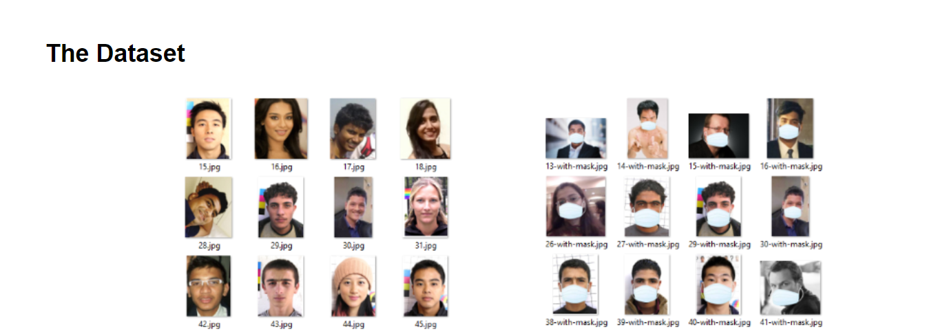
Dataset(contd.)

Slide 9
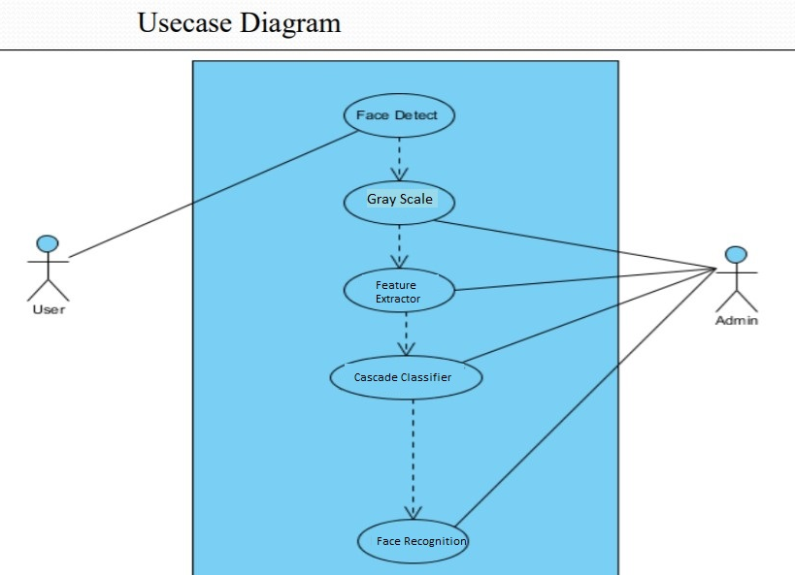
Project Planning
First we loaded the data from the dataset.
Then, we classified into mask and no mask.
After classification, we stored them in Dataset and Target set.
After this, we train the dataset with the required model and got the accuracy 96%.
Then, we loaded the model and loaded as casket classifier for face detection.
Then we read the video and converted them into Gray Scale. We resized the image and reshaped into 4 dimensions.

Slide 10
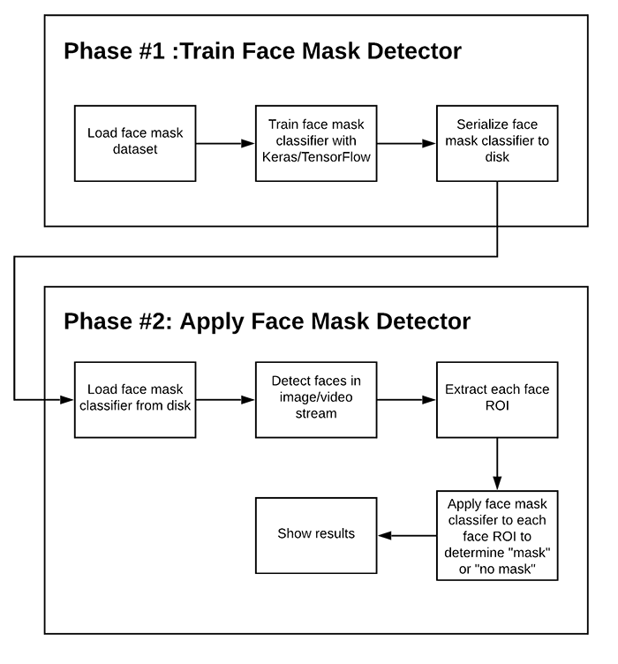
Working
The collected RAW data was passed through: -
Stage 1 (Face Detector) and the Intermediate
Processing Block of the architecture. This
process was carried out to ensure that the distribution and nature of training data for Stage 2 match the expected input for Stage 2 during the final deployment

Slide 11
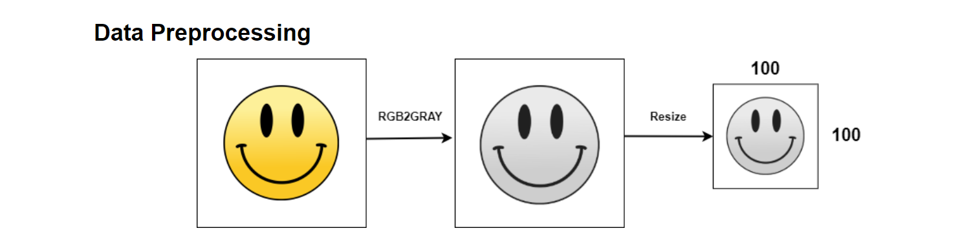
Contd…(Stage 2)
For the second stage, three CNN classifiers were trained for classifying images as masked or unmasked. The models were trained using the Keras framework.
Data augmentation was performed using the ImageDataGenerator class in Keras. The input image size was set as 100X100. We Selected an initial learning rate of 0.001.
Besides this, the training process included checkpointing the weights for best loss, reducing the learning rate on the plateau, and early stopping. Each model was trained for the dataset and the lowest validation loss was selected.

Slide 12
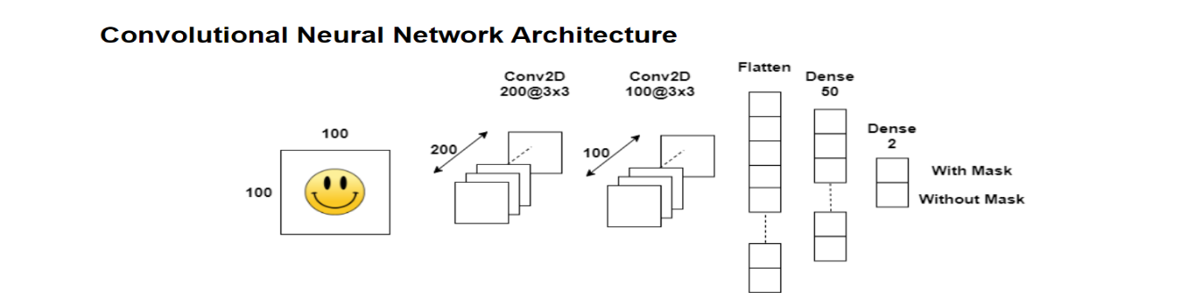
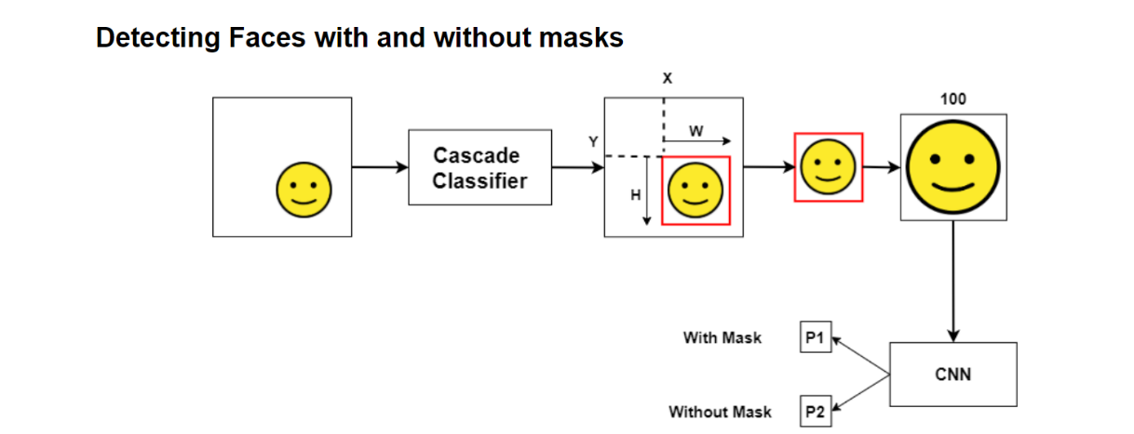
Contd…
Stage 3

Slide 13
Contd..
Combining all the components of our architecture, we thus get a highly accurate and robust Face Mask Detection System.
Retina Face was selected as our Face Detector in Stage 1, while the CNN based model was selected as our Face Mask. Classifier in Stage 2. The resultant system exhibits high performance and has the capability to detect face masks in images with mask faces over a wide range of angles.
Until now, we have seen that our system shows high performance over images,
Overcoming most of the issues commonly faced in object detection in images. For real-world scenarios, it is beneficial that the detection system to work well over video feeds as well.

Slide 14
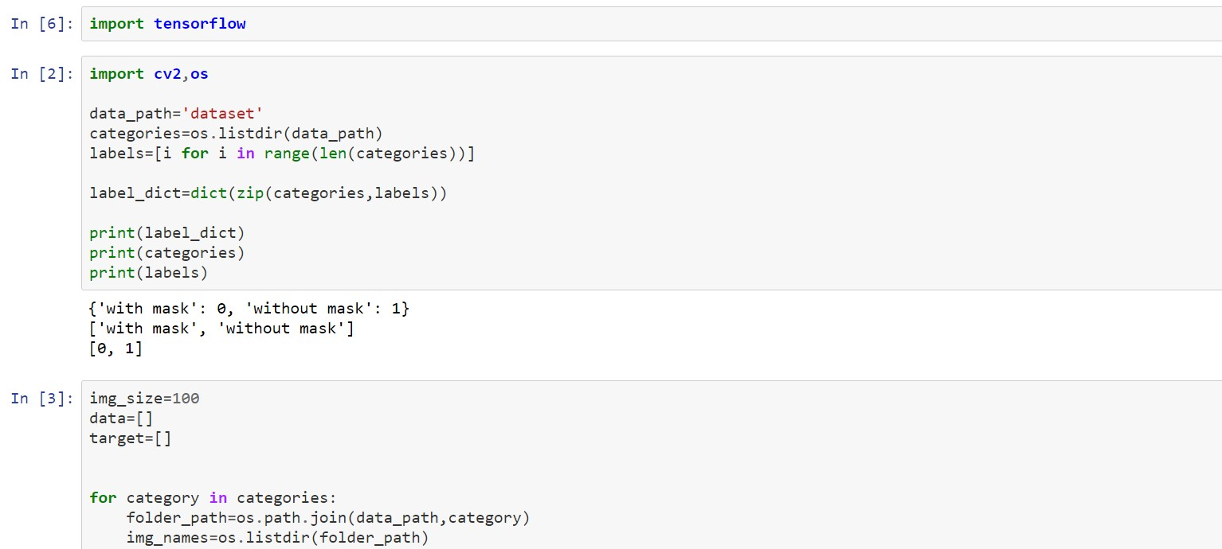
IMPLEMENTATION: Data Preprocessing

Slide 15
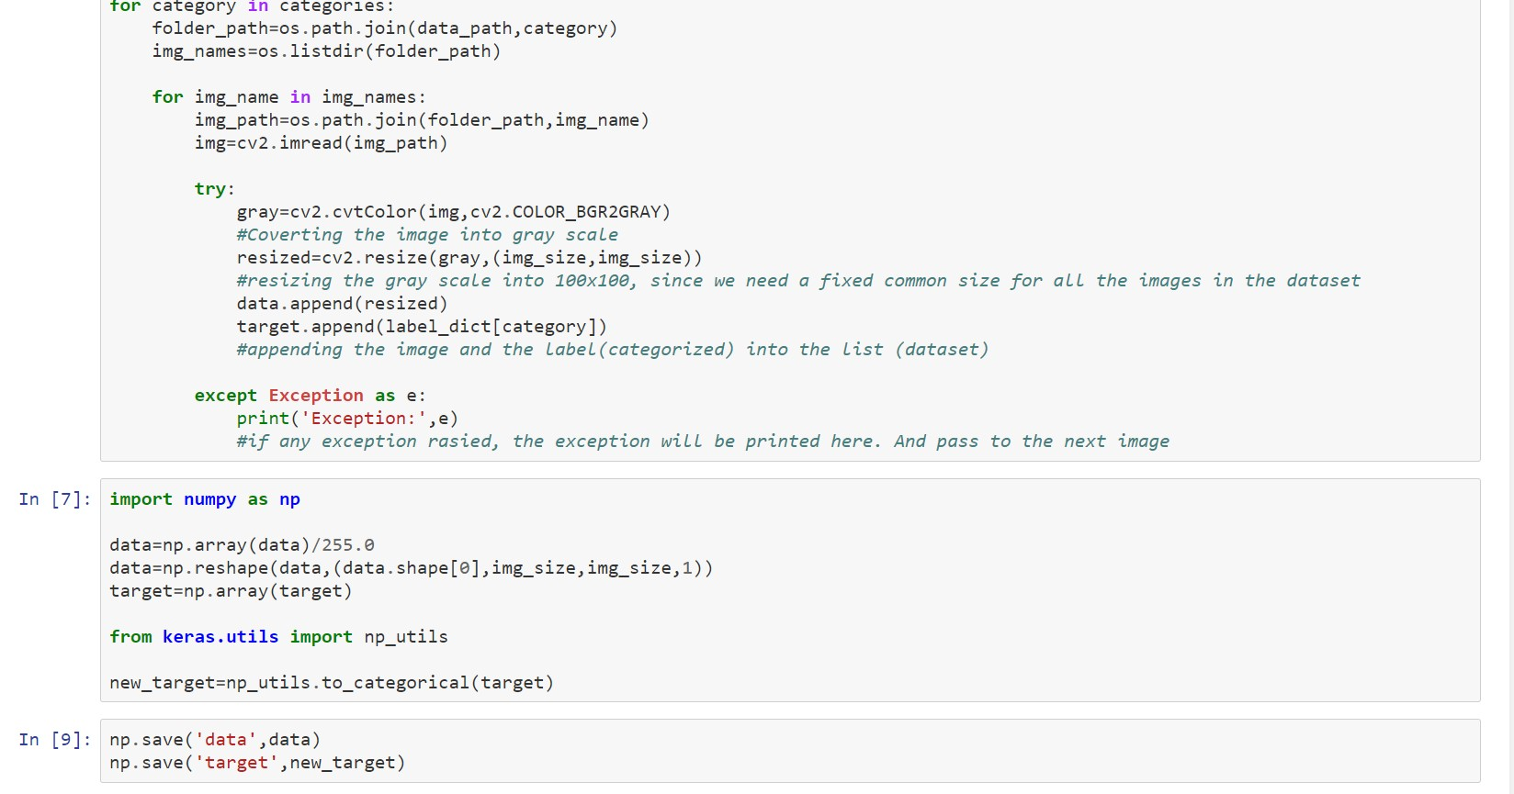
Data Preprocessing(contd.)

Slide 16
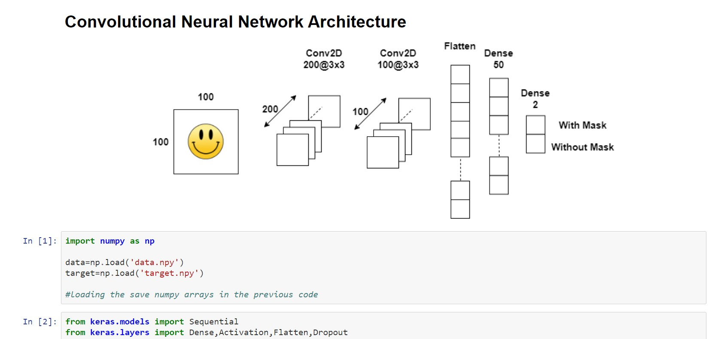
Training the CNN

Slide 17
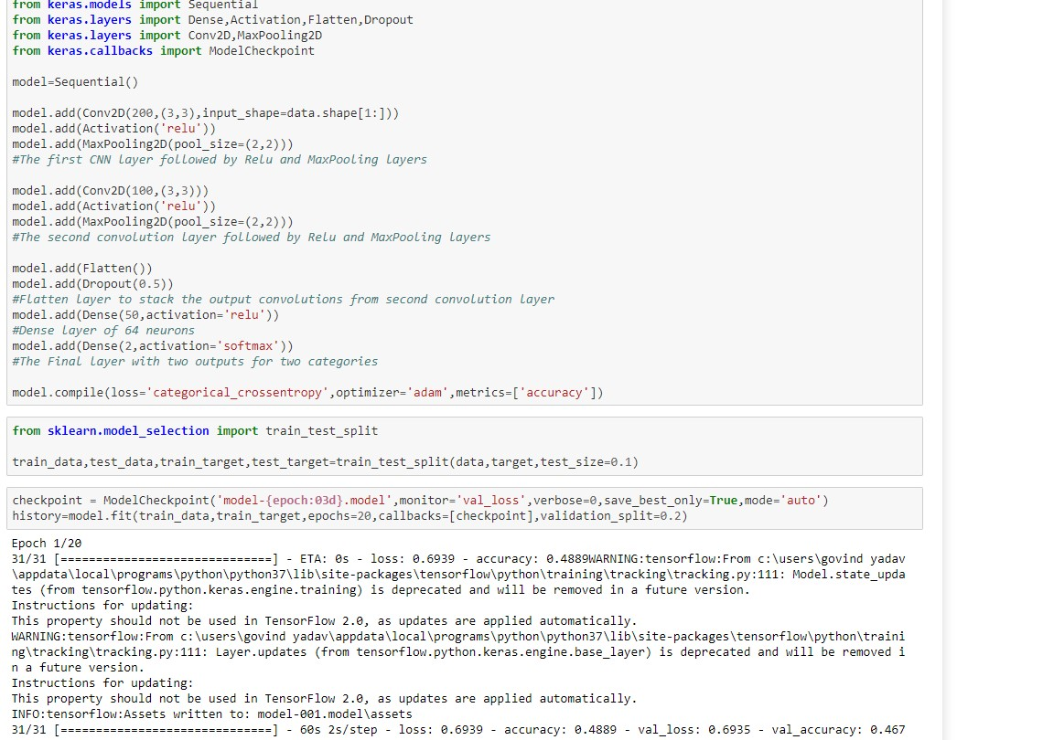
continue...

Slide 18
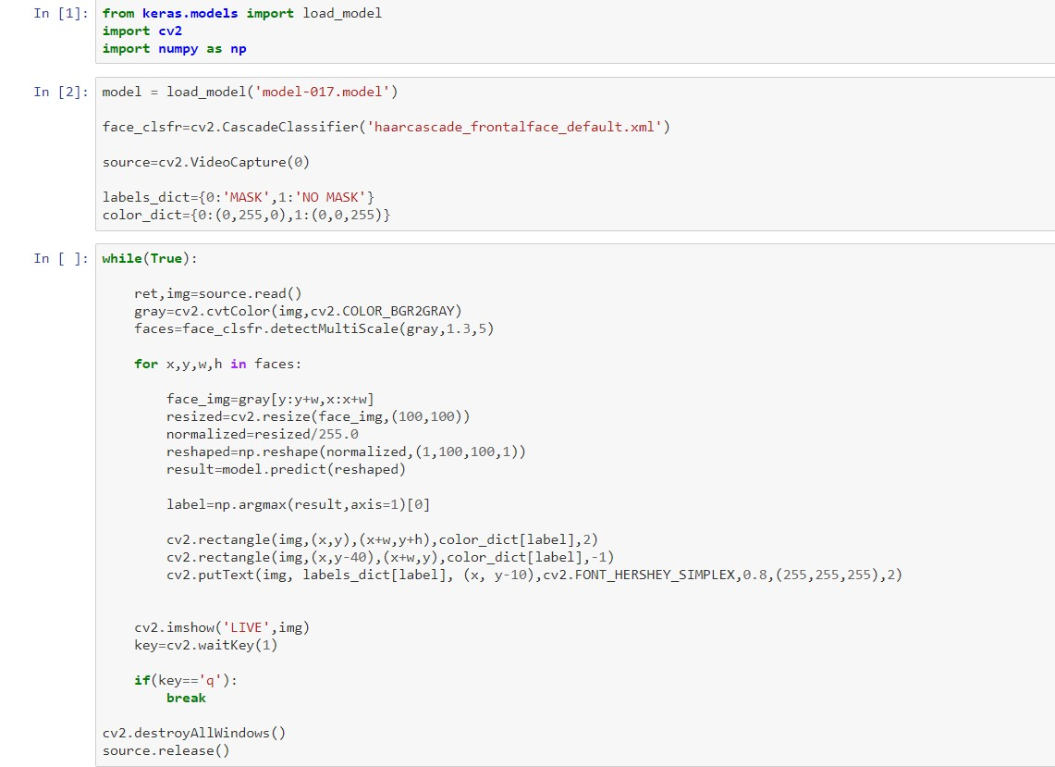
Detecting Mask

Slide 19

continue…

Slide 20
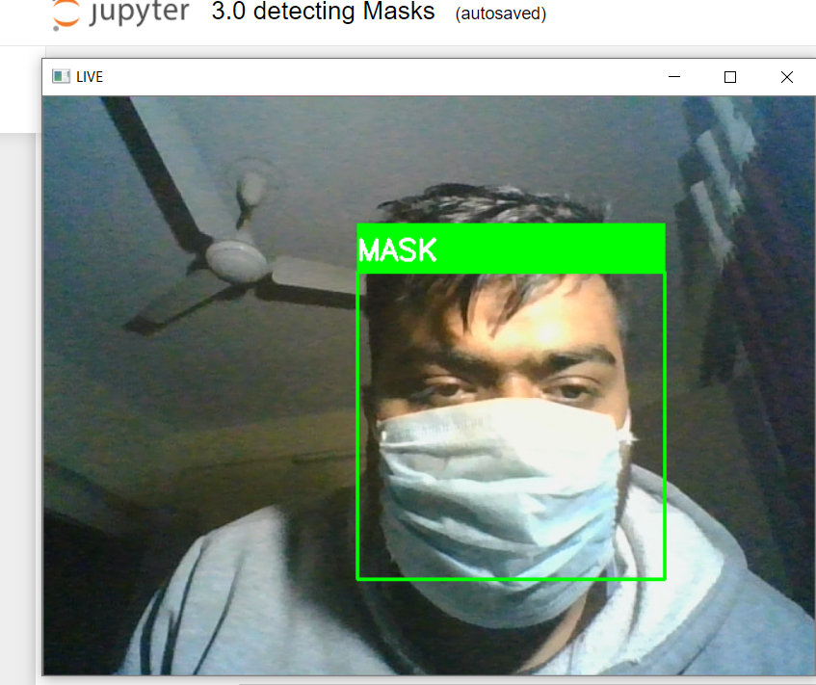
Results:- With Mask

Slide 21
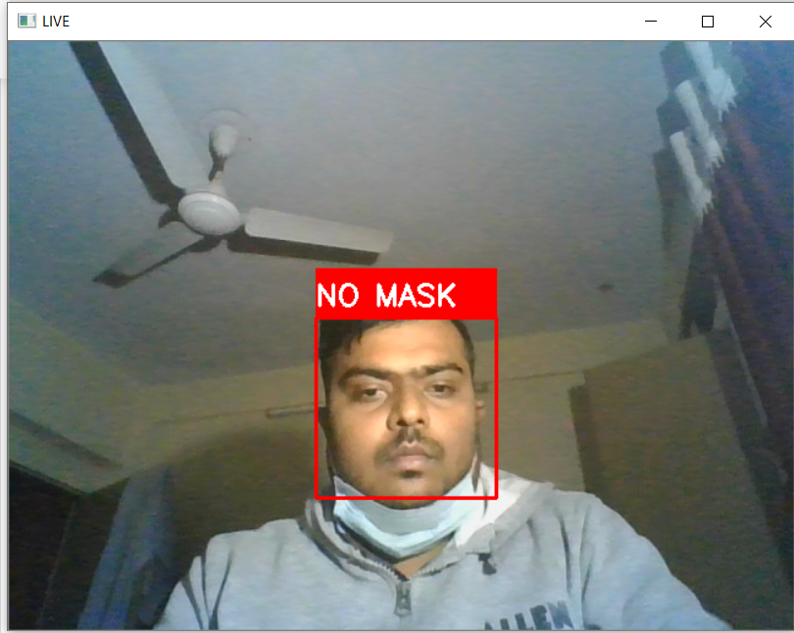
Without Mask:

Slide 22
Future Works
There are a number of aspects we plan to work on shortly:
Currently, the model gives 5 FPS inference speed on a CPU. In the future, we plan to improve this up to 15 FPS, making our solution deployable for CCTV cameras, without the need of a GPU.
The use of Machine Learning in the field of mobile deployment is rising rapidly. Hence, we plan to port our models to their respective TensorFlow Lite versions.
Our architecture can be made compatible with TensorFlow Run Time (TFRT), which will increase the inference performance on edge devices and make our models efficient on multithreading CPUs.
Stage 1 and Stage 2 models can be easily replaced with improved models in the future, that would give better accuracy and lower latency.

Slide 23
CONCLUSION
Corporate giants from various verticals are turning to AI and ML, leveraging technology at the service of humanity amid the pandemic. Digital product development companies are launching mask detection API services that enable developers to build a face mask detection system quickly to serve the community amid the crisis. The technology assures reliable and real-time face detection of users wearing masks. Besides, the system is easy to deploy into any existing system of a business while keeping the safety and privacy of users’ data. So the face mask detection system is going to be the leading digital solution for most industries, especially retail, healthcare, and corporate sectors.

Slide 24


